Slide 1
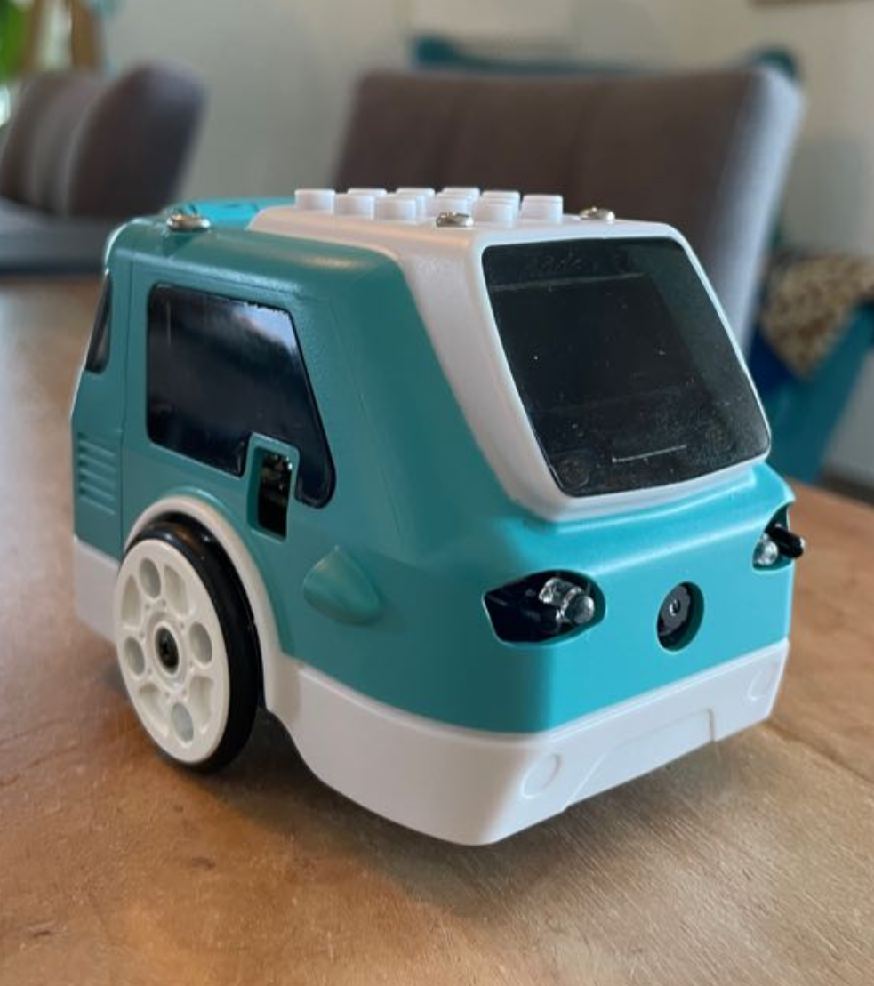
Zumi 7337
Team presentation
Simone Wullschleger
Mykhailo Andrusiak
Lea Schönauer

Slide 2
Presentation Overview
Successful Implementation Highlight of what worked well & why
Unsuccessful implementation Challenge we faced & what didn’t work
Lessons Learned
Team Q&A

Slide 3
Successful Implementation: Mapping with Manhattan Distance
How can we track Zumi’s movement without a GPS?
Output: Map and total distance travelled

Slide 4
Tracking Zumi’s Movement
Using seconds as a unit
Game of Life inspired grid
Extracting movement pairs using our log events
Updating grid
Exporting plot
0 | 0 | 0 | 0 | 0 | 0 | 0
0 | 0 | 0 | 0 | 0 | 0 | 0
0 | 0 | 0 | 0 | 0 | 0 | 0
0 | 0 | 0 | 0 | 0 | 0 | 0
0 | 0 | 0 | 0 | 0 | 0 | 0
0 | 0 | 0 | 0 | 0 | 0 | 0
0 | 0 | 0 | 0 | 0 | 0 | 0
0 | 0 | 0 | 0 | 1 | 1 | 0
0 | 0 | 0 | 0 | 0 | 1 | 0
0 | 0 | 0 | 1 | 1 | 1 | 0
0 | 0 | 0 | 1 | 0 | 0 | 0
0 | 0 | 0 | 0 | 0 | 0 | 0

Slide 5
Unsuccessful implementation
Vibration during running:
- Possible reason for a line_correction() function
- Possible solution is changing angle correction

Slide 6
Lessons Learned
Robots react to their environment
Test small, save big
Leverage what you already know

Slide 7

Team Q&A

